Slide 1
Blood Donation Management System
A simple system to find the right blood donor quickly.
Presented By
Nova Cinco
MD. Abdul Karim
Id : 2243081080
Sajjadul Islam Noman
Id:2243081059
Asadujjaman Nayeem
Id : 2243081055
Jihadul Islam Siam
Id:2243081047
Nafis Khan
Id : 2243081070
Uttara University| 2025

Slide 2
1
Introduction
Finding blood during an emergency is often hard and stressful. People may not know where to find the right donor quickly.
This Blood Donation Management System is a simple C# console application that connects blood donors with people who need blood based on location and blood group. The goal of this project is to make blood donation faster, easier, and more organized

Slide 3
2
Objective of the project
To create a system that connects blood donors with people who need
blood
To help users find suitable blood donors quickly in emergency situations
To manage donor and consumer information in an organized way
To allow consumers to send blood requests easily
To use Object-Oriented Programming (OOP) concepts in a real-life
project

Slide 4
3
Features of the System:
User Management
Donor Features
Consumer Features
Blood Request Management
Donor Search
Programming and Design Features

Slide 5
4
User Management
User Registration Allows new donors and consumers to create an account.
User Login Let’s users log in using phone number and password.
Phone Number Validation Prevents multiple accounts using the same phone number.
Password Protection Keeps user passwords secure using private variables.

Slide 6
5
Donor Features
Donor Profile Creation Donors can create an account with basic information.
Edit Donor Details Donors can update address and blood group anytime.
View Blood Requests Donors can see nearby blood requests that match their blood group.
Accept Blood Request Donors can accept a request and help a patient.
View Accepted Requests Donors can see the requests they already accepted.
Last Donation Tracking The system stores the donor’s last blood donation date

Slide 7
6
Consumer Features
Consumer Profile Consumers can view their personal account information.
Send Blood Request Consumers can request blood by entering location, hospital, and time.
View Request Status Consumers can check if their request is accepted or not.

Slide 8
7
Blood Request Management
Create Blood Request Stores blood group, quantity, date, time, and hospital
details.
Automatic Request ID Each request gets a unique ID automatically.
Date and Time Handling Date and time are stored using the DateTime class.
Request Acceptance System Once accepted, donor details are saved with the request.

Slide 9
8
Donor Search
Search Donors by Location Finds donors based on division, district, and thana.
Blood Group Matching Shows only donors with the required blood group.

Slide 10
9
System & Design Features
Console-Based System The application runs using a menu-driven console interface.
OOP-Based Design The system is built using Object-Oriented Programming
concepts.
Error Handling Prevents system crash using try-catch blocks.
Centralized Data Management Uses static classes to manage users and blood requests.

Slide 11
10
OOP Concept Used
Class & Object The system is built using classes like Person, Donor, Consumer and
BloodRequest.
Inheritance Doner and Consumer inherit common properties from the Person class.
Encapsulation User password is protected using private variables and public
properties.
Abstraction The abstract Request class hides common request details and is
implemented by BloodRequest.
Method Reusability Common operations are reused through methods in management
classes.

Slide 12
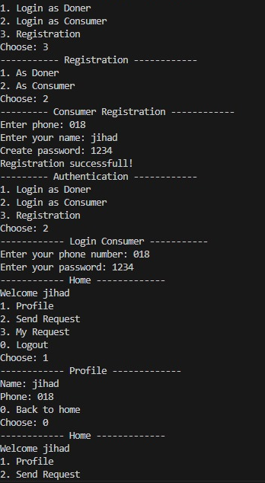
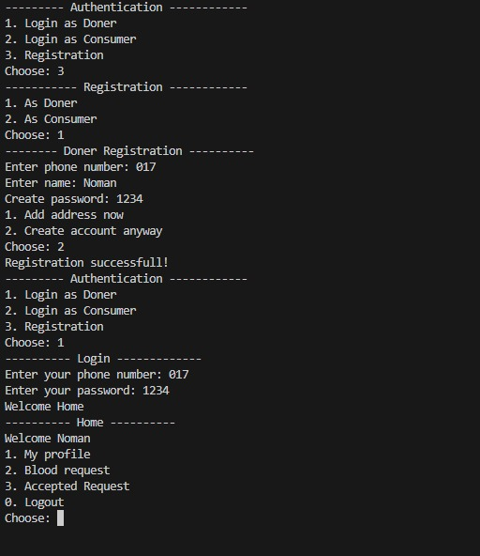
11
Output: Registration
Consumer Registration:
Donor Registration:

Slide 13
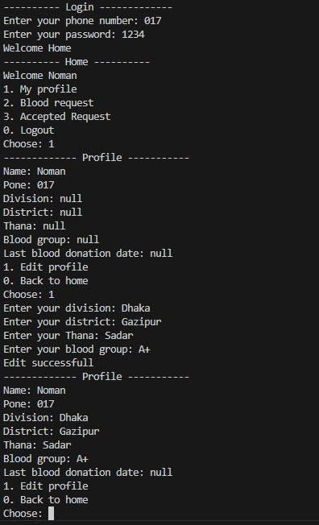
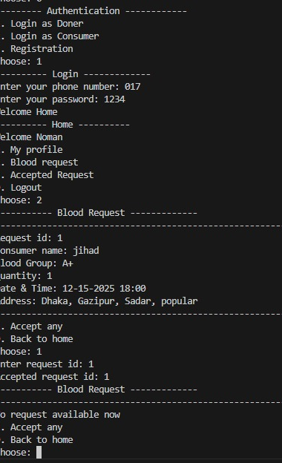
12
Output: Donor section
Donor profile :

Slide 14
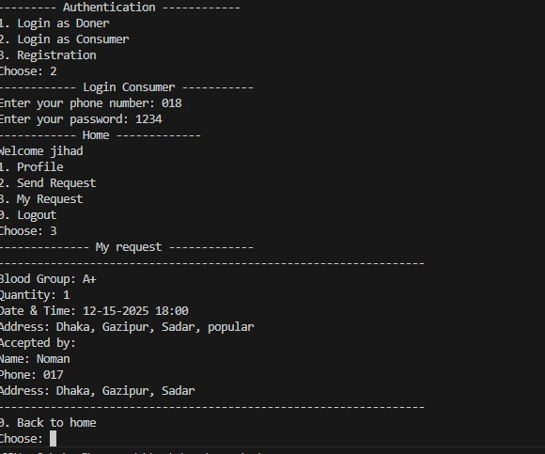
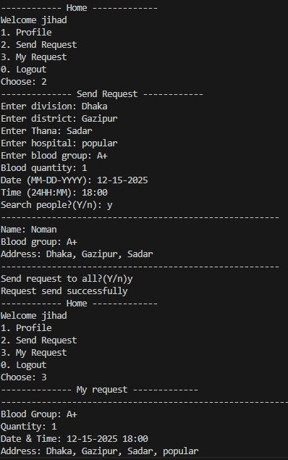
13
Output: Consumer section
Consumer profile :

Slide 15
14
Uses and Benefits
Helps find blood donors quickly in emergency situations
Connects donors and patients by location and blood group
Saves time by showing only matching blood requests
Keeps donor and patient information organized
Easy to use with a simple menu-based system

Slide 16
15
Problems Faced during Development
Helps find blood donors quickly in emergency situations
Connects donors and patients by location and blood group
Saves time by showing only matching blood requests
Keeps donor and patient information organized
Easy to use with a simple menu-based system

Slide 17
16
Conclusion
This project successfully connects blood donors and
people in need
It makes the blood request process faster and more
organized
The system applies core OOP concepts using C#
It helped us improve our problem-solving and
programming skills
The project can be improved further for real-world use in
the future

Slide 18
Thank you for listening to our presentation.
Uttara University

